Slide 1
Validation & Verification
Mr Mahmud

Slide 2
Learning Objective
11.1.2.5 explain the difference between the terms verification and validation
Lesson objectives
Learners can explain the terms validation and verification;
Learners can find the correct type of validation in situations;
Learners know how add validation in project.
Assessment criteria
Know the difference between validation and verification;
Can add the validation to project.

Slide 3
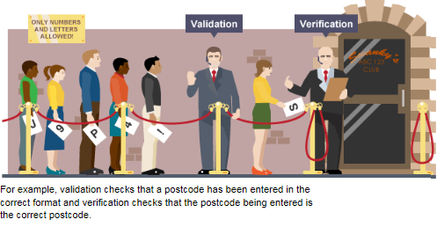
Validation checks that the correct type of data is entered, whereas verification checks that the data is actually the data you want.

Slide 4
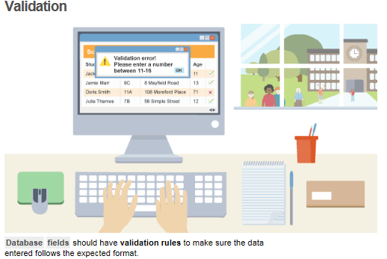

Slide 5
validation
Validation is a check made by a program to ensure that the data entered is reasonable.
NB: It cannot ensure that the data is correct!

Slide 6
Types of Validation
Presence check
Type check
Format check
Length check
Lookup check
Range check
Check digit

Slide 7
Validation type | How it works | Example usage
Check digit | The last one or two digits in a code are used to check the other digits are correct | Bar code readers in supermarkets use check digits
Format check | Checks the data is in the right format | A National Insurance number is in the form LL 99 99 99 L where L is any letter and 9 is any number
Length check | Checks the data isn't too short or too long | A password which needs to be six letters long
Lookup table | Looks up acceptable values in a table | There are only seven possible days of the week
Presence check | Checks that data has been entered into a field | In most databases a key field cannot be left blank
Range check | Checks that a value falls within the specified range | Number of hours worked must be less than 50 and more than 0
Spell check | Looks up words in a dictionary | When word processing

Slide 8
Activity
Watch this in your own time: https://youtu.be/iS9tqYuVQ08
Complete the Quiz Questions!
Complete

Slide 9
Discussion
How can we detect errors that occurred during data transmission?

Slide 10
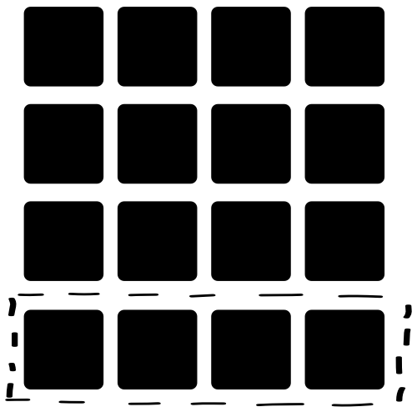
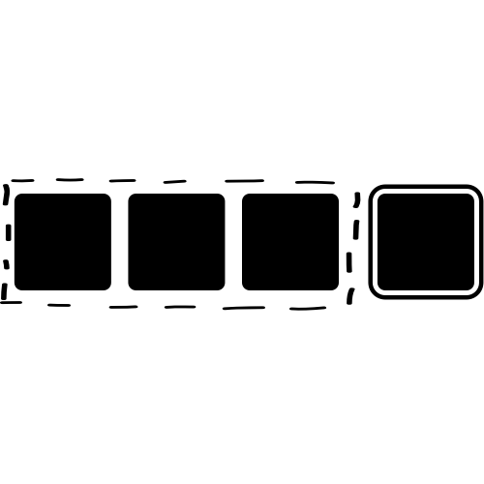
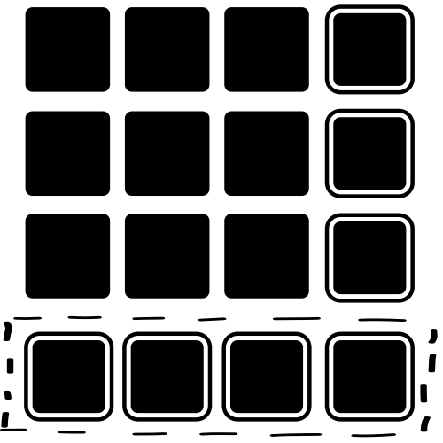
Error detection
Checksums
Parity bits
Parity blocks
A checksum algorithm is run on a block of data. The checksum calculated is then transmitted with the data. When the data is received the sum is calculated again. If it does not match the checksum sent with the block of data an error has occurred.
A parity bit is added as the last bit in a byte of data. The parity bit is used to keep the total number of 1-bits even or odd depending on whether even or odd parity is being used.
A parity byte is added to a block of data. The bits for the parity byte are calculated using the above column of data. If an incorrect parity for a row and a column are detected the exact position of the error can be located at the intersection.

Slide 11
Parity Check (bit)
A parity check determines whether bits in a transmission have been corrupted
Every byte transmitted has one of its bits allocated as a parity bit
The sender and receiver must agree before transmission whether they are using odd or even parity
If odd parity is used then there must be an odd number of 1’s in the byte, including the parity bit
If even parity is used then there must be an even number of 1’s in the byte, including the parity bit
The value of the parity bit is determined by counting the number of 1’s in the byte, including the parity bit
If the number of 1’s does not match the agreed parity then an error has occurred
Parity checks only check that an error has occurred, they do not reveal where the error(s) occurred

Slide 12
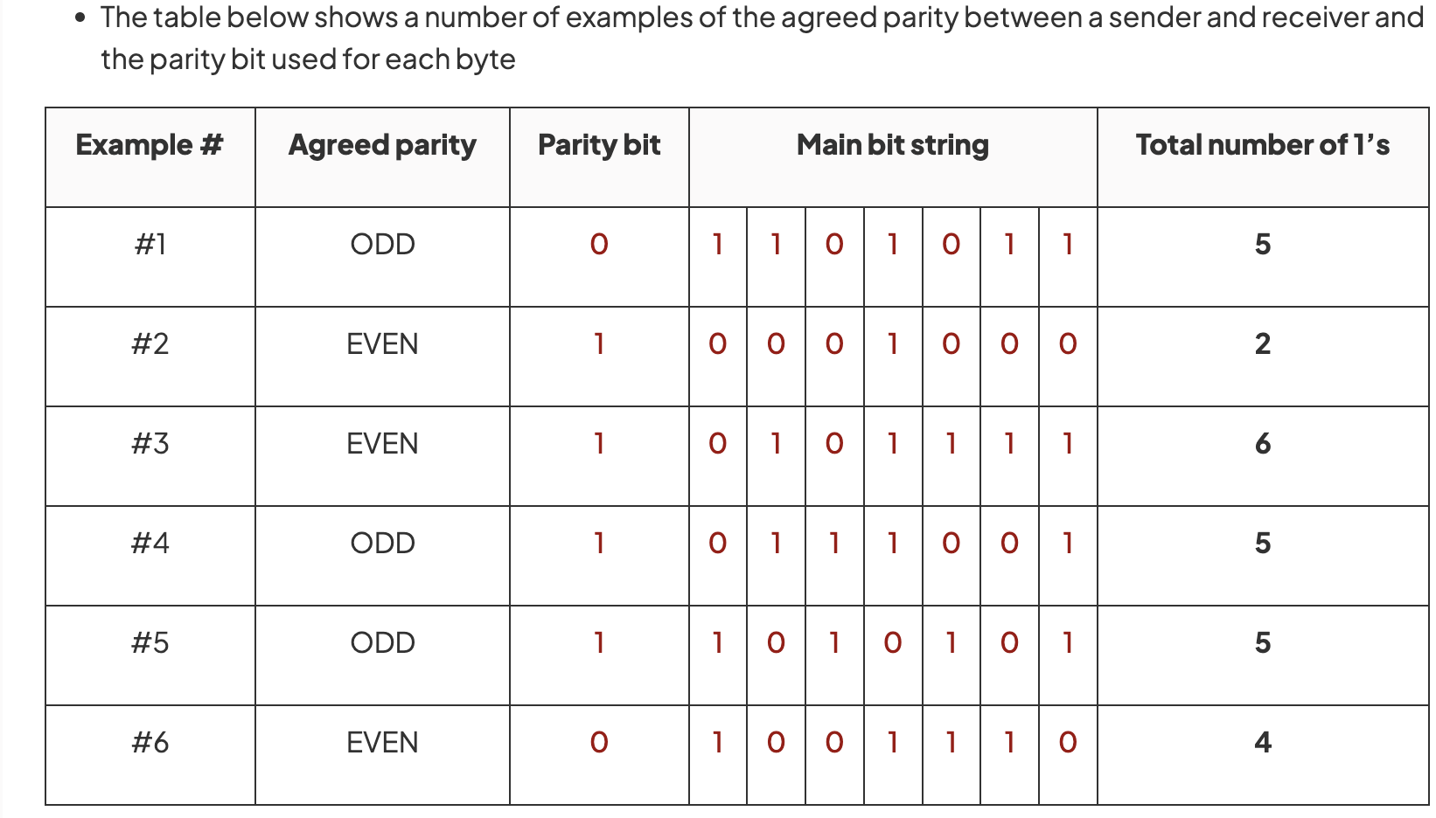

Slide 13
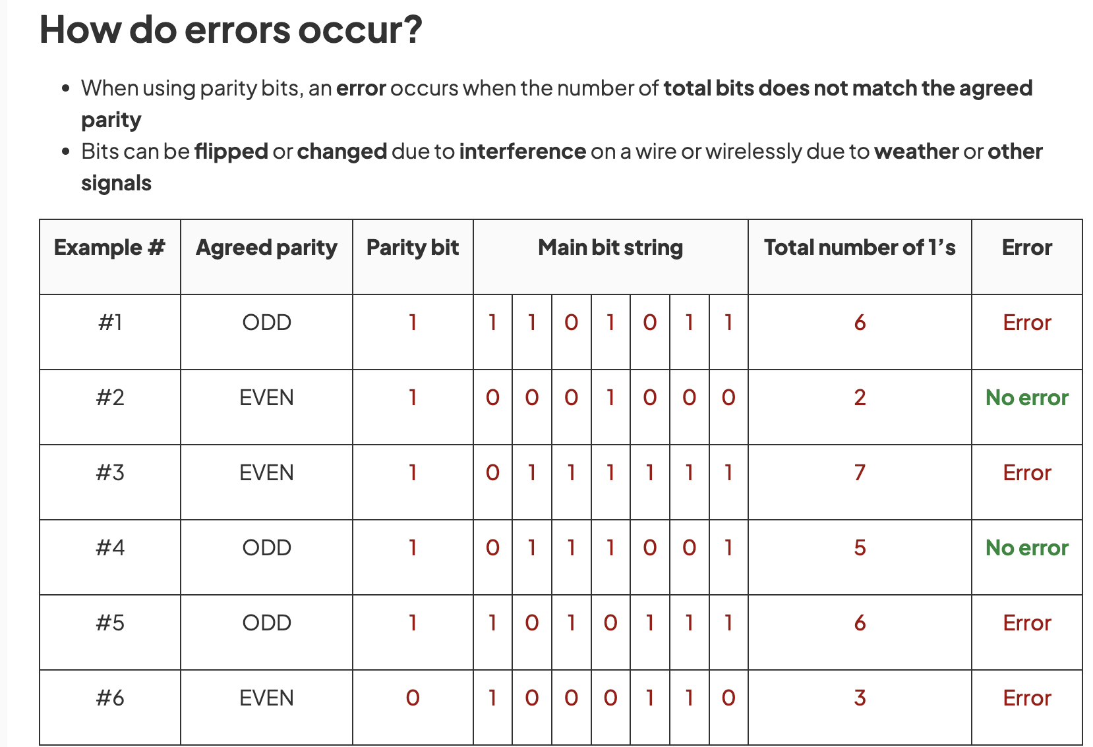

Slide 14
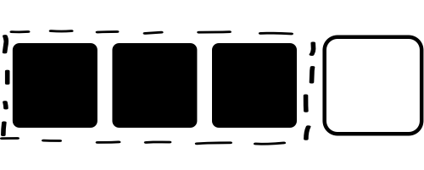
Parity checks
Set the parity bit using even parity.
Set the parity bit using odd parity.
0 1 1
1 0 1
parity bit
5. (a) Complete the parity bits for each nibble of data.
(b) Will the use of a parity bit always detect errors?

Slide 15
Parity Block
Parity block checks are used in data storage and data transmission systems to add an additional layer of error detection to a group of bytes (usually a larger chunk of data).
They are similar in concept to parity bits, but instead of applying parity to individual bits within a byte, they apply it to a group of parity bytes.
The purpose of parity bytes is to detect errors in a larger data unit, such as a block of data, rather than just individual bits or bytes.
By using parity bytes, you can detect errors in the entire data block more effectively.
https://youtu.be/jLuj62Gq-1I - in your own time

Slide 16
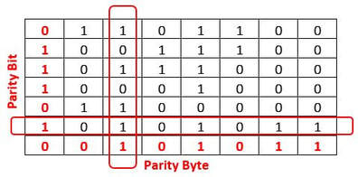

Slide 17
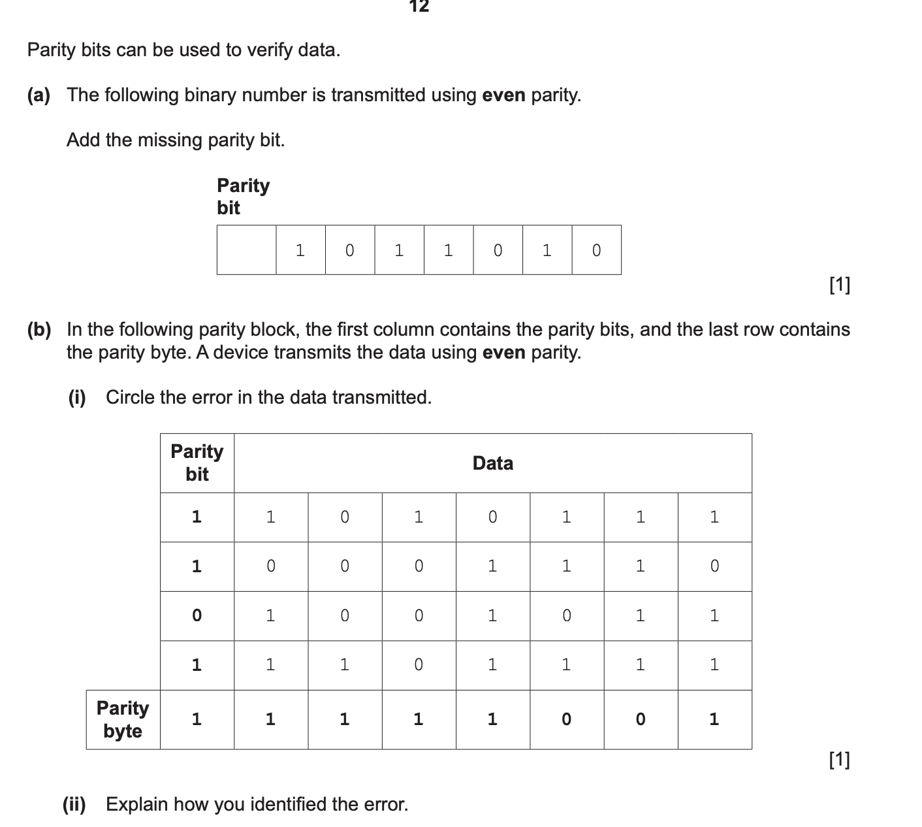

Slide 18
Checksum
A checksum is a value that can be used to determine if data has been corrupted or altered
It indicates whether data differs from its original form but does not specify where
Checksums are calculated using an algorithm and the value is added to the transmission
The receiving device re-calculates the checksum and compares to the original
If the checksums do not match, it is assumed an error has occurred

Slide 19
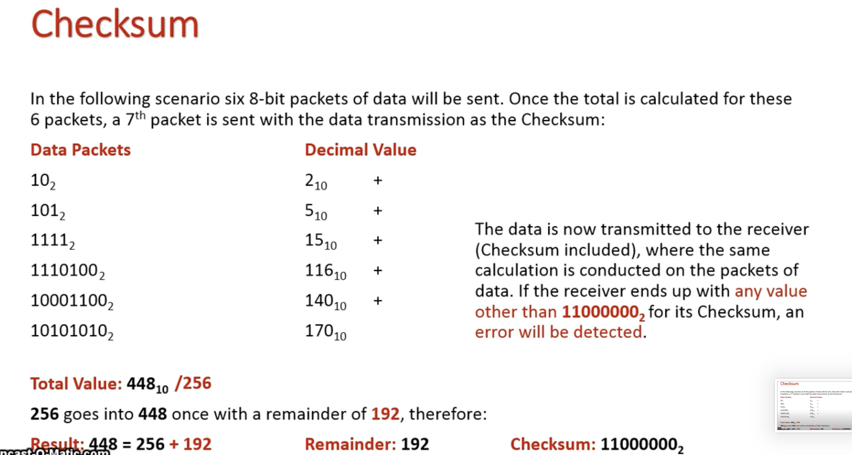

Slide 20
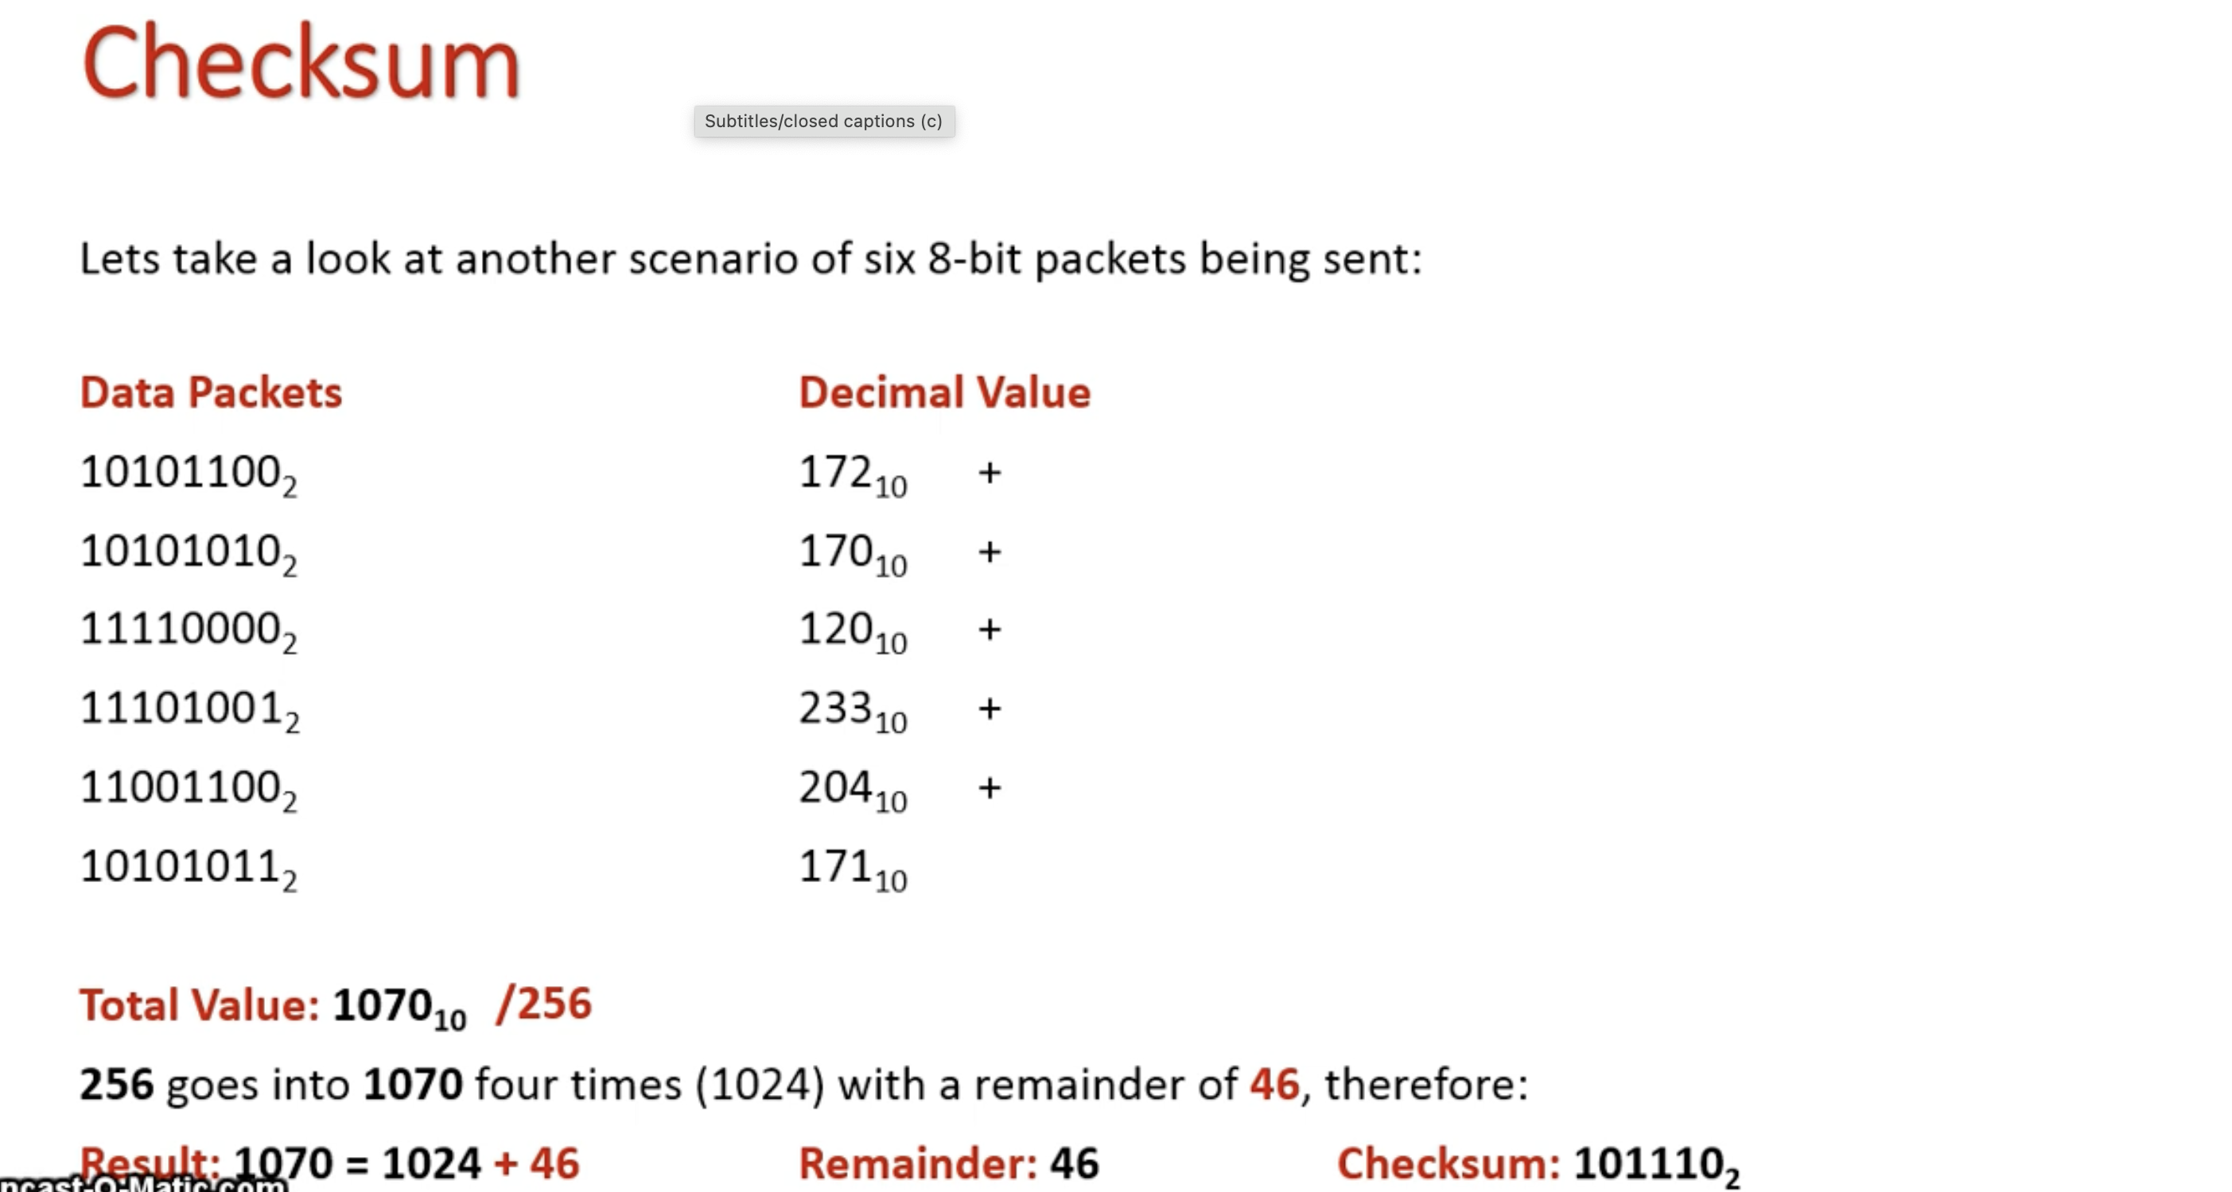

Slide 21
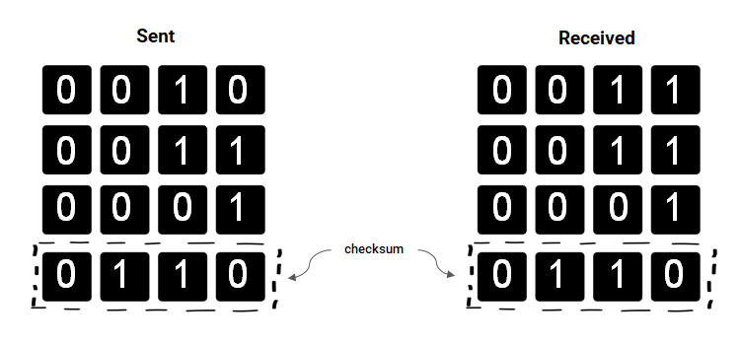
Checksums
4. (a) Circle the bit that got flipped and caused the error to be detected?
(b) What could go wrong using this method of error detection?

Slide 22
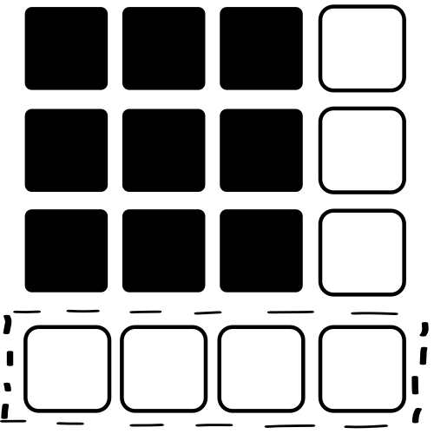
Parity block checks
0 0 1
1 0 1
0 1 1
Parity byte
(nibble in this case)
6. (a) Complete the parity bits for each nibble of data.
(b) What are the advantages of this method?
(c) What if two bits in one of the nibbles are flipped?

Slide 23
Fill in the blanks
Checksums
A checksum ____________ is run on a block of data. The _____________ calculated is then transmitted with the data. When the data is received the checksum is ______________ again. If it does not match the checksum sent with the __________ of data an error has occurred.
Parity blocks
A _______________ is added to a block of data. The bits for the parity byte are calculated using the above ______________ of data. If an incorrect parity for a row and a column are ________________ the exact position of the error can be located at the ___________________.
7. Fill the blanks for each paragraph.

Slide 24
Verification
Verification is performed to ensure that the data entered exactly matches the original source.
There are two main methods of verification:
Double entry - entering the data twice and comparing the two copies. This effectively doubles the workload, and as most people are paid by the hour, it costs more too.
Two Factor Authentication – verifying someone through password then SMS
Proofreading data - this method involves someone checking the data entered against the original document. This is also time-consuming and costly.

Slide 25
Look at the video
https://www.youtube.com/watch?v=gQrSxbfUjug&ab_channel=Udacity

Slide 26
Why?
Explain why we need to validate and verify input data.
Saves time correcting errors later
GIGO – garbage in, garbage out
Ensures completeness
Ensures consistency. Queries difficult if criteria inconsistent.
Security. Certain strings can present security concerns.
Prevent runtime errors eg when text is entered instead of a number
Correctness. Email wrong customers - costly, embarrassing.

Slide 27
Data Testing
It is important to test algorithms to check how they perform under a range of conditions.
This includes testing any validation you have created to ensure it performs as expected.
When creating a testing plan, the test data that you use shouldn’t be random values, but rather values that fulfill the following test criteria.
Normal data
Normal data is test data that is typical (expected) and should be accepted by the system.
Boundary data (extreme data)
Boundary data (sometimes called extreme data) is test data at the upper or lower limits of expectations that should be accepted by the system.
Abnormal data (erroneous data)
Abnormal data is test data that falls outside of what is acceptable and should be rejected by the system.

Slide 28
Example of normal data, boundary data and abnormal data:
A system has validation to ensure that only numerical values between 2012 – 2025 are entered as an input.
The test data for this could be:
Normal data: 2012-2025 Boundary data (extreme data): 2012 Boundary data (extreme data): 2025 Abnormal data (erroneous data): 1945, twenty twenty

Slide 29
Reflection
Have we met the learning objectives?

